Slide 1
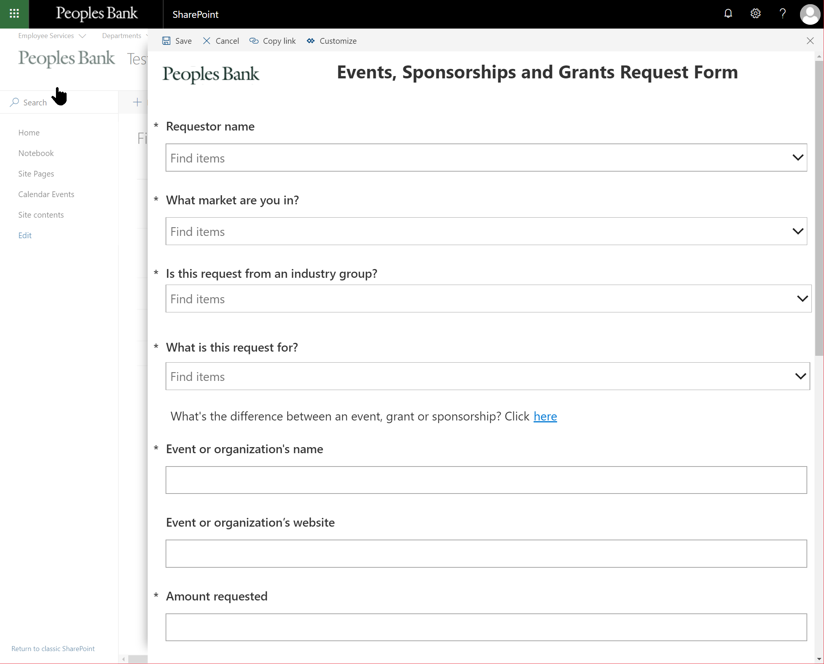
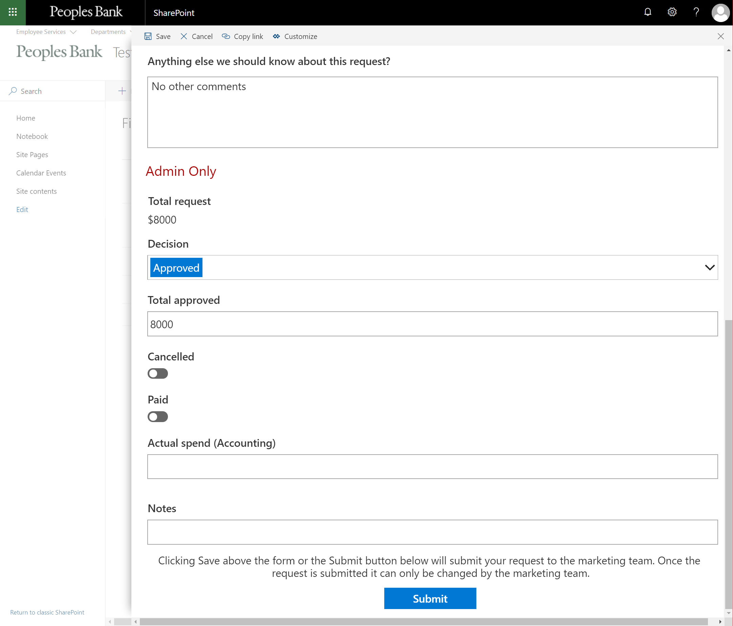
People’s Bank PowerApps Development
Business Need
People’s Bank needed a highly dynamic, user-friendly way to manage event, sponsorship, and grant requests. Their existing process required handling over 100 fields and 60 sets of conditional rules, making manual administration slow, inconsistent, and difficult to scale. They needed an automated solution that could guide users, enforce rules, and streamline the full review workflow.
What We Did
Built a PowerApps-driven form with over 100 fields and 60+ conditional rules to guide users through structured data entry
Implemented cascading dropdowns, custom validations, and data integrations to ensure accuracy and reduce manual input
Created an automated SharePoint site provisioning workflow using PowerApps, Power Automate, Azure, and the PnP Provisioning Engine
Developed a mobile-friendly PowerApps with offline capabilities so users could submit requests directly from any device.
Results
Streamlined how users submit requests, ensuring all required information is captured consistently and accurately
Provided administrators with a centralized view and control over spending, approvals, and annual review processes
Automated notifications and milestone updates to marketing teams and request originators, improving communication and visibility
Reduced manual processing time and improved operational efficiency across all request types.

